Slide 1


Slide 2
COPD ASTHMA and RF

Slide 3
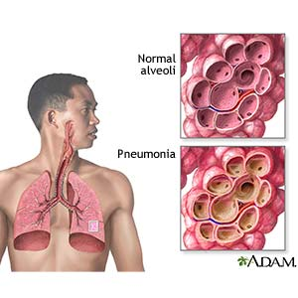

Slide 4
Definition of COPD
Chronic Obstructive Pulmonary Disease (COPD) is a common preventable and treatable disease state characterised by persistent respiratory symptom and airflow limitation that is not fully reversible.
This is due to airway and or alveolar abnormalities usually caused by significant exposure to noxious particles or gases, primarily caused by cigarette smoking.

Slide 5
Host factors | Exposures
Genetic factors Sex Airway hyperreactivity, IgE and asthma | Smoking Socio-economic status Occupation Environmental pollution Perinatal events and childhood illness Recurrent bronchopulmonary infections Diet

Slide 6
Pathogenesis and Pathophysiology
Pathogenesis
Tobacco smoking is the main risk factor for COPD, although other inhaled noxious particles and gases may contribute.
In addition to inflammation, an imbalance of proteinases and antiproteinases in the lungs, and oxidative stress are also important in the pathogenesis of COPD.
Pathophysiology
The different pathogenic mechanisms produce the pathological changes which, in turn, give rise to the physiological abnormalities in COPD:
mucous hypersecretion and ciliary dysfunction,
airflow limitation and hyperinflation,
gas exchange abnormalities,
pulmonary hypertension,
systemic effects.

Slide 7
Diagnosis of COPD (1)
Diagnosis of COPD should be considered in any patient who has the following:
symptoms of cough
sputum production
dyspnoea
history of exposure to risk factors for the disease
Spirometry should be obtained in all persons with the following history:
exposure to cigarettes and/or environmental or occupational pollutants
family history of chronic respiratory illness
presence of cough, sputum production or dyspnoea

Slide 8
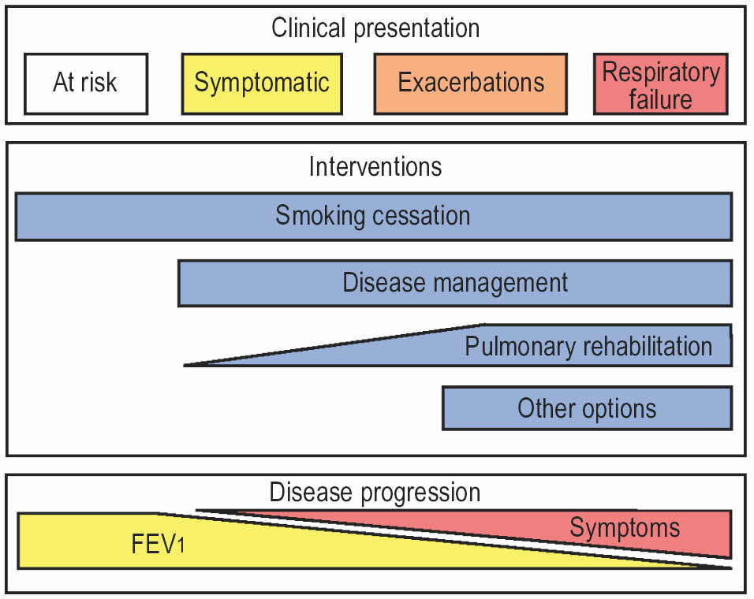
Diagnosis of COPD (4)

Slide 9
Management of stable COPD
Pharmacological therapy
Long-term oxygen therapy
Pulmonary rehabilitation
Nutrition
Surgery in and for COPD
Sleep
Air travel

Slide 10
Bronchodilators
Short-acting bronchodilators:
β-agonists : Salbutamol ( Farcolin) ; inhaled , oral.
S.E Tremor , Tachcardia
Anticholinergics : ipratropium ( Atrovent) inhaled.
Long acting bronchodilator:
Long-acting inhaled β-agonists
Long acting inhaled Anticholinergic.
Theophyllines
Slowly IV, oral. S.E: arrythmia, GIT.

Slide 11
Pharmacological therapy (4) Bronchodilators
Short-acting bronchodilators can increase exercise tolerance acutely in COPD.
Anticholinergics given q.i.d. can improve health status over a 3-month period.
Long-acting inhaled β-agonists improve health status, possibly more than regular ipratropium. Additionally, these drugs reduce symptoms, rescue medication use and increase the time between exacerbations.
Combining short-acting agents (salbutamol/ipratropium) produces a greater change in spirometry over 3 months than either agent alone.
Combining long-acting inhaled β-agonists and ipratropium leads to fewer exacerbations than either drug alone.
Combining long-acting β-agonists and theophylline produces a greater spirometric change than either drug alone.
Tiotropium improves health status and reduces exacerbations and hospitalisations compared with both placebo and regular ipratropium.

Slide 12
Pharmacological therapy (5) Glucocorticoids
Glucocorticoids act at multiple points within the inflammatory cascade, although their effects in COPD are more modest compared with bronchial asthma.
In patients with more advanced disease (usually classified as an FEV1 <50% predicted), there is evidence that inhaled corticosteroids can reduce the number of exacerbations per year.

Slide 13
COPD exacerbation

Slide 14
Definition, evaluation and treatment (1)
The definition of COPD exacerbation is an acute change in a patient’s baseline dyspnoea, cough and/or sputum beyond day-to-day variability sufficient to warrant a change in therapy.
Causes of exacerbation can be both infectious and non-infectious.
Medical therapy includes bronchodilators, corticosteroids, antibiotics and supplemental oxygen therapy.

Slide 15
Definition, evaluation and treatment (2)
Indications for hospitalisation of patients with a COPD exacerbation
Presence of high-risk co-morbid conditions, including pneumonia, cardiac arrhythmia, congestive heart failure, diabetes mellitus, renal or liver failure
Inadequate response of symptoms to outpatient management
Marked increase in dyspnoea
Inability to eat or sleep due to symptoms
Worsening hypoxaemia
Worsening hypercapnia
Changes in mental status
Inability of the patient to care for her/himself
Uncertain diagnosis
Inadequate home care

Slide 16
Investigation
Chest X-ray.
Arterial Blood Gas.
Other.

Slide 17
Exacerbation of COPD
Definition, evaluation and treatment
In-patient oxygen therapy
Assisted ventilation

Slide 18
In-patient oxygen therapy
The goal is to prevent tissue hypoxia by maintaining arterial oxygen saturation (Sa,O₂) at >90%.
Main delivery devices include nasal cannula and venturi mask.
Alternative delivery devices include nonrebreather mask, reservoir cannula, nasal cannula or transtracheal catheter.
Arterial blood gases should be monitored for arterial oxygen tension (Pa,O₂), arterial carbon dioxide tension (Pa,CO₂) and pH.
Arterial oxygen saturation as measured by pulse oximetry (Sp,O₂) should be monitored for trending and adjusting oxygen settings.
Prevention of tissue hypoxia supercedes CO₂ retention concerns.
If CO₂ retention occurs, monitor for acidaemia.
If acidaemia occurs, consider mechanical ventilation.

Slide 19
Exacerbation of COPD
Definition, evaluation and treatment
In-patient oxygen therapy
Assisted ventilation

Slide 20
Asthma Management in Clinical Practice

Slide 21
Definition of asthma
Asthma is a disease, usually characterized by chronic airway inflammation.
It is defined by the history of respiratory symptoms such as wheeze, shortness of breath, chest tightness and cough that vary over time and in intensity, together with variable expiratory airflow limitation.

Slide 22

Diagnosis of Asthma
History of Recurrent Symptoms
Shortness of breath
Rule Out Other Causes of Symptoms
Document Presence of Airflow Obstruction
PEFR Spirometry
Demonstrate Reversibility of Obstruction/Symptoms

Slide 23
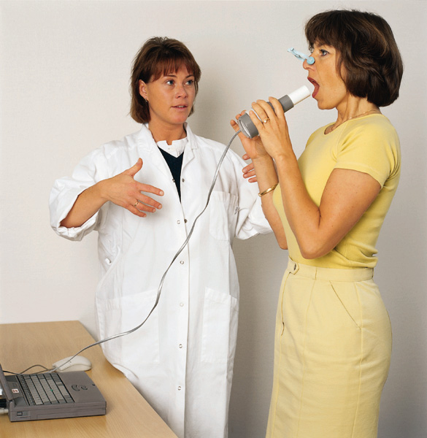
Clinical follow up of asthma
FEV₁ measurement
Notes:
The most common method of assessing airflow obstruction is to measure the forced vital capacity (FVC) and forced expired volume in one second (FEV₁) using a spirometer. The patient takes a full deep breath in and is then asked to breathe out as fast as possible and for as long as possible. FVC is the total volume of air breathed out; FEV₁ is the volume breathed out during the first second

Slide 24
ICS in Asthma
ICS (inhaled corticosteroid) are the recommended first-line therapy for persistent asthma of all severities and patients of all ages and are the most effective asthma medications currently available.
Pharmaceuticals 2010, 3, 514-540

Slide 25
ICS in Asthma (cont.)
When taken regularly, inhaled corticosteroids:
Effectively control everyday asthma symptoms.
Improve lung function.
Decrease the risk for exacerbations.
Fernando D Martinez et al,Lancet 2013; 382: 1360–72

Slide 26
LABA with ICS for Asthma Management
ICS therapy in combination with long acting inhaled beta agonists (LABA) represents the most important treatment for asthma.
ICS therapy forms the basis for treatment of asthma of all severities, improving asthma control, lung function and preventing exacerbations of disease.
Eur J Clin Pharmacol (2009) 65:853–871

Slide 27
Exacerbations of asthma
are episodes of rapidly progressive increase in SOB, cough, wheezing, chest tightness, and respiratory distress.
Cause : infectious; viral, Non infectious.

Slide 28
Manegement
Inhaled short acting bronchodilator (Nebulizer).
Systemic corticosteroid.
Slowly IV uniphylline.
IV fluids
Oxygen therapy.
ICU referral???

Slide 29
Respiratory Failure

Slide 30
Definition
Failure in one or both gas exchange functions: oxygenation and carbon dioxide elimination
Types
Acute , Chronic
Type I ( Hypoxemia: decrease oxygen level in blood).
Type II ( Hypercapnia: Increase CO2 level in blood).

Slide 31
Causes of type I RF
COPD ( early in disease)
Pneumonia
Pulmonary edema
Pulmonary fibrosis
Asthma
Pneumothorax
Pulmonary embolism
Cyanotic congenital heart disease
Bronchiectasis .

Slide 32
Causes of type II RF
stroke, tumors , brain injuries.
Respiratory centre dysfunction, drug over- dose, hypothyroidism.
Spinal injuries, Guillain-Barre, polio .

Slide 33
Chest wall/pleural diseases ; morbid obesity, kyphoscoliosis, pneumothorax, massive pleural effusion.
Upper airways obstruction; tumor, foreign body, laryngeal edema
Peripheral airway disorder & lung parenchyma; asthma, COPD, massive fibrosis.

Slide 34
Brainstem
Spinal cord
Airway
Nerve root
Lung
Nerve
Pleura
Neuromuscular junction
Chest wall
Respiratory muscle
Sites at which disease may cause ventilatory disturbance
Notes:
Or the problem may be decreased compliance of the lung itself, the pleura or the chest wall.

Slide 35
How to diagnose a case with RF?
This needs to follow these items:
1- High sense of clinical suspicion
2- Careful history taking & clinical exam.
3- Confirmation of the diagnosis of RF
with arterial blood gas (ABG) testing.
4- Other investigations to discover the
underlying disease.

Slide 36
Clinical manifestations related to hypoxemia & hypercapnea ( all are non-specific and unreliable & are usually related to cardiovascular, GIT & CNS )
Cyanosis: bluish color of mucous membranes/ skin indicates hypoxemia & unoxygenated hemoglobin >5 g/DL ( not a sensitive indicator) .
Respiratory; dyspnea: secondary to hypercapnia and hypoxemia.

Slide 37
Management of respiratory failure: principles;
Primary objective is to reverse and prevent hypoxemia with O2 therapy ( Mask).
Monitoring of the patient in the ICU
Treatment of the underlying disease

Slide 38

Thank you

